Slide 1
Acute Myeloid Leukemia Outcome Prediction Challenge
Chia-Hsuan Chou
Venkata Prudhvi Raj Indana
Jing Wang

Slide 2
Background
Acute Myeloid Leukemia (AML) – a cancer of bone marrow and the blood.
AML is a relatively rare disease, accounting for about 1.2% of cancer deaths in the US. But its incidence is expected to increase when population ages.
AML is caused by various mutations in the myeloid line of blood stem cells and genetic events.

Slide 3
About the Data
A total of 191 patients’ measurements is provided as training data.
There are total of 271 measurements captured by M.D. Anderson Cancer Center.
The measurements include 40 covariates describing patient demographics, cytogenics and mutation status, and the results of several standard blood tests.

Slide 4
Goal
The ultimate goal of this challenge is to interpret the dataset of AML patients and try to figure out what drives AML.
A predictive model will be proposed to help physicians to better assess patient’s potential response to treatment.
Further steps would include to predict the corresponding remission time and to predict survival time of patients after treatment.

Slide 5
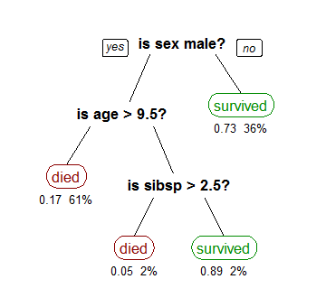

Proposed Method I
Perform classification and build a decision tree to predict patients’ treatment responses.
Target column is “resp.simple”, which gives two outcomes, CR and RESISTANT, which represents the categorization of patients who have a complete response or to be resistant to treatment.
According to the 270 attributes, we can use greedy algorithm combined with Information Gain method to learn a decision tree given 191 patients’ dataset.
Information Gain plus greedy algorithm allow us to find the best parameter to split the data at every step.
Apply test data through the decision tree to get prediction.

Slide 6
Proposed Method II
First, calculating the similarity between patients and get closest k patients. Then, weight the similarity and calculate the total weight so that we can get the prediction for either CR or Resistant.
Several ways to compute the similarity, such as Euclidean distance, Pearson correlation or Manhattan distance which can evaluate the distance between patients.
Suppose we use Euclidean distance, we’ll get the similarity of patient 1 and patient 2. Select closest k patients and use the reciprocal of the distance (the similarity) for the prediction.
We can use cross-validation to estimate the performance and try the best k value.

Slide 7
Proposed Method III
Build a Random forest model by using python’s scikit learn package and train the model
Random forest is an ensemble learning model that operates by constructing numerous decision trees at training time and outputs class that is mode of classes predicted by decision trees
Use n fold cross validation and stratified resampling to validate results of prediction.

Slide 8
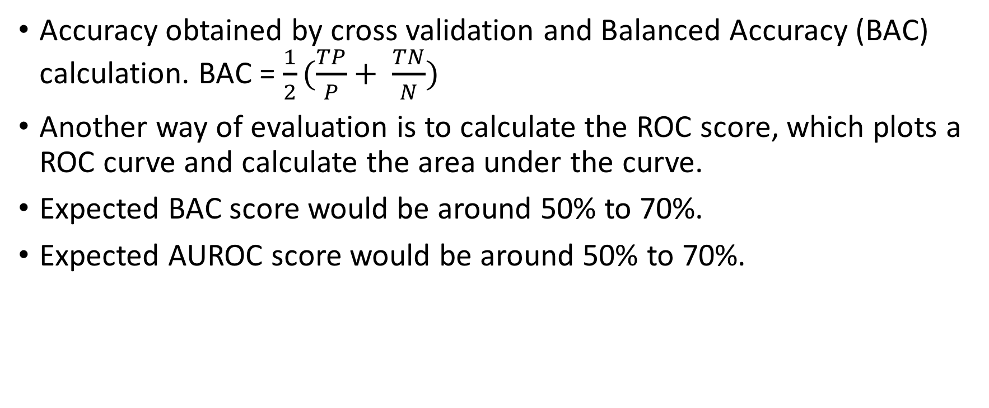
Expected Outcome
Accuracy obtained by cross validation and Balanced Accuracy (BAC) calculation. BAC = $\frac{1}{2}(\frac{TP}{P}+ \frac{TN}{N})$
Another way of evaluation is to calculate the ROC score, which plots a ROC curve and calculate the area under the curve.
Expected BAC score would be around 50% to 70%.
Expected AUROC score would be around 50% to 70%.

